Slide 1
IST 615
Project Pre-Presentation
Facilities Management System
For University Sports and Fitness Center
By
Hitesh Thadhani
Prachi Sankpal
Rashika Singh
Sai Praharsha Devalla
Tejas Dinesh Patil
Yeswanth Reddy Velapalem

Slide 2
Product Idea and Relevance
The Facilities Management System product is used for tracking and making reservations to access the facilities at a university fitness center.
Often students want to use services such as the tennis court, basketball court, etc. at the university sports and fitness center.
Students have to wait for a very long time as it not possible for them to keep the track of the available slots.
The system that we are going to propose will enable the students to easily keep track of available services at the sport and fitness center. If they wish, they will also be able to book a time slot for any service on any given day, provided the center is operational on those days..

Slide 3
Competitor Analysis
No direct competitor found, but there were some products somewhat similar to our product ideas.
Kourts: It is an application which allows the user to book and play at a nearby tennis clubs. The application is open source and can be accessed by anyone. On the other hand, the system we are building is more secure and allows only the students of the university to access the facilities.
Existing Application: It is only limited to esports.

Slide 4

Scope Definition
The main goal of the system is to allow booking of the available facilities in real-time.
Only university students and staff can access the system.
This application can be used only at university-level for checking the availability.
Real-time updates will be made to the system on successful booking using unique ID.

Slide 5
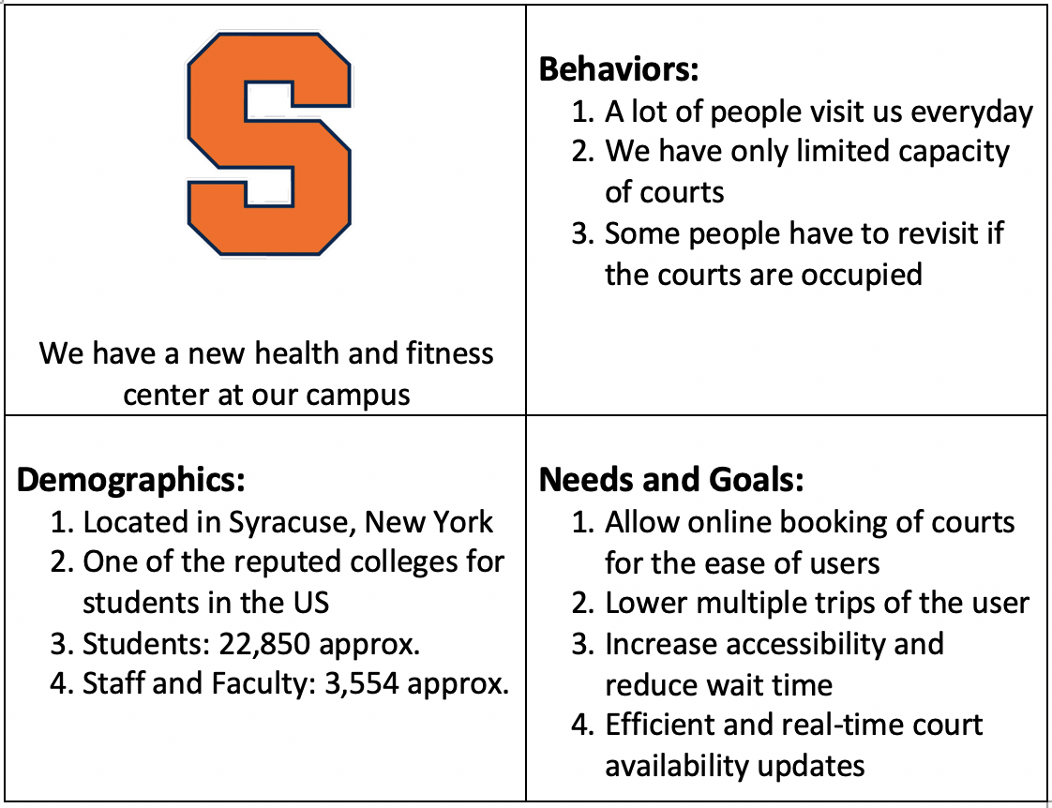
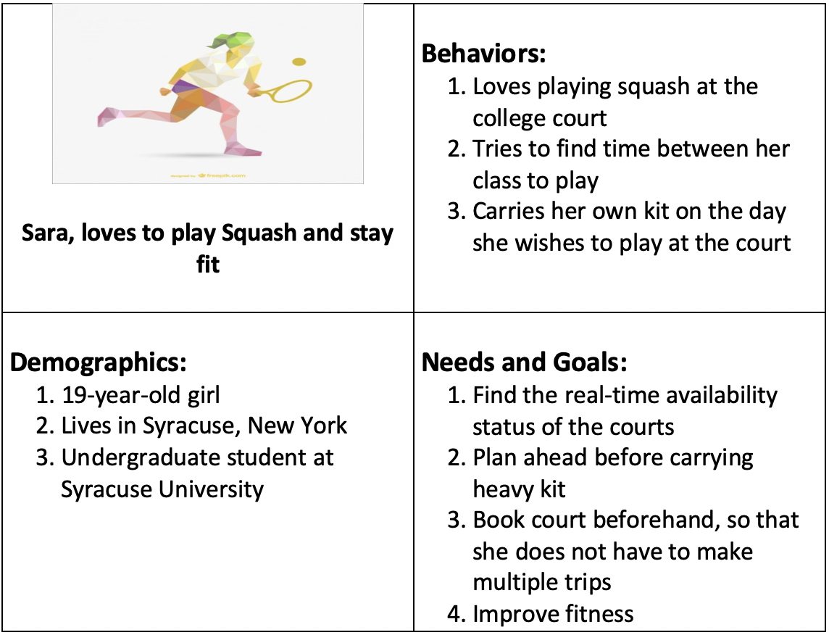
Stakeholders
Notes:
The primary stakeholder in this context is the University to which the sporting and fitness center belongs
The secondary users will be the students/faculty of the university who will utilize the services

Slide 6
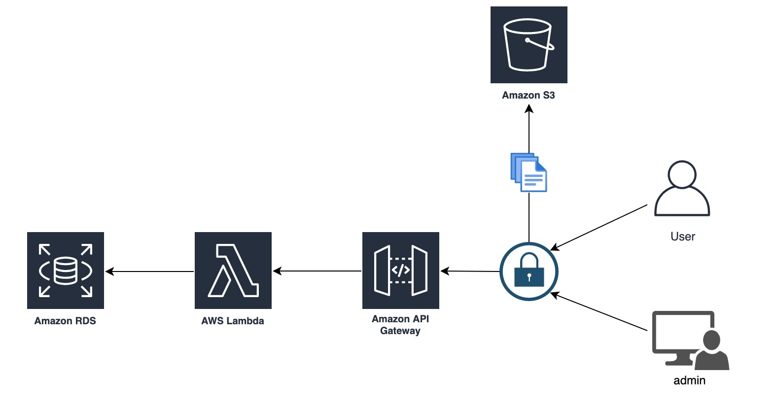
Proposed Architecture

Slide 7
Cost Model
Service | Monthly Cost per Unit ($) | Quantity Required | Total Monthly Costs ($)
Amazon API Gateway | 10.00 | 1 | 10.00
Amazon Simple Storage Service | 23.55 | 1 | 23.55

Slide 8
Amazon EC2 instance | 51.35 | 1 | 51.35
Amazon Lambda | 0.00 | 1 | 0.00
Amazon RDS | 83.39 | 1 | 83.39
Total Costs for AWS Services |  |  | 168.29

Slide 9
Revenue Model
The upfront cost of buying the product will be at a price of $25,000.
There will be cost of $4000 for renewing the subscription yearly.
There is an additional maintenance cost of $500 monthly.
If the University needs any additional features, they can pay an extra amount based on the complexity of the feature.
The initial system will be functional for 5000 users after which any additional user will need a payment of $50.
The monthly maintenance will also cover any failure or repairs needed by the system.

Slide 10
Goals and Expectations
Our goal is to provide online facility of booking a sports room based on the availability.
Build a online website for the university students and staff to be able to book the recreational sports room online to reduce wait time.
Demonstrate an online booking of a court for a specific sport.

Slide 11
Thank You

